Slide 1
A Length Adaptive Algorithm-Hardware Co-design of Transformer on FPGA Through Sparse Attention and Dynamic Pipelining

Slide 2
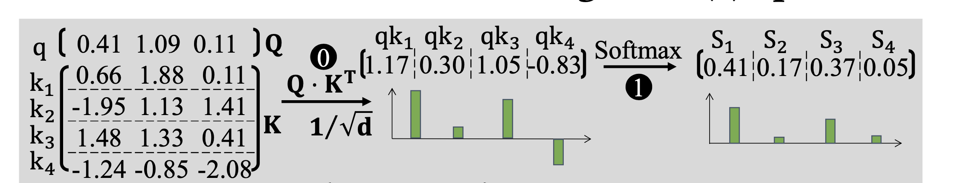
Normal Calculation
Input is transformed into three distinct matrices: Q (Query), K (Key), and V (Value).
Compute attention scores matrix, S, by multiplying Q and the transpose of K (S = Q·K𝑇).
Each row in S represents the dot-product between a corresponding row in Q and all rows in K.
Apply softmax operation on the attention scores matrix, S.
Softmax normalizes the attention scores, emphasizing relative values over absolute values.
Importance lies in the relative values of attention scores, not their absolute magnitude.

Slide 3
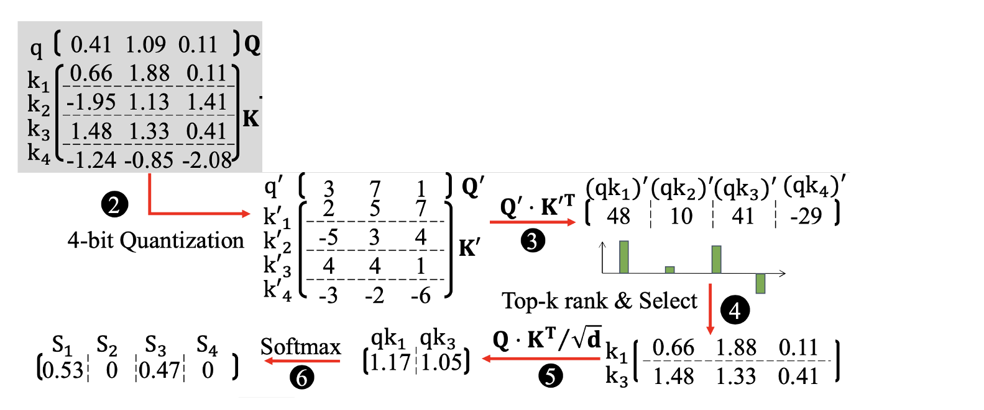
Modified Calculation
Both quantization and exponential functions in softmax are monotonically increasing.
This ensures that the order of attention scores is maintained after quantization.
Utilize fast quantized matrix multiplication to highlight dominant attention values.
Implement Top-k sorting to identify and select the highest-ranked attention scores.
Only the Top-k attention scores undergo exact matrix multiplication.
This approach is faster than the original, focusing computation on the most significant attention scores.
Results in more accurate and efficient softmax values calculation.

Slide 4
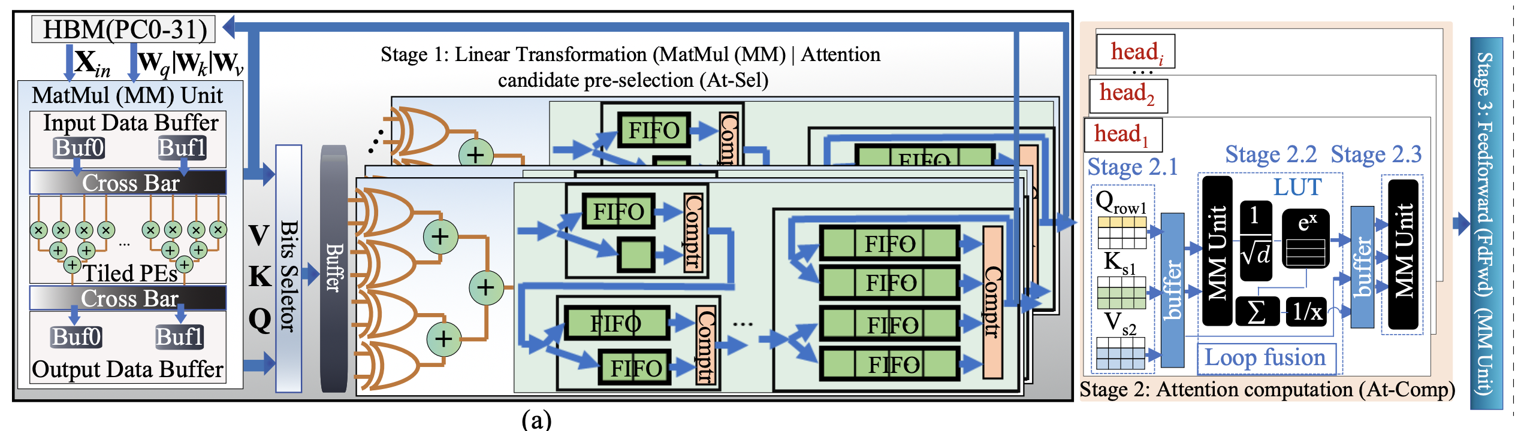
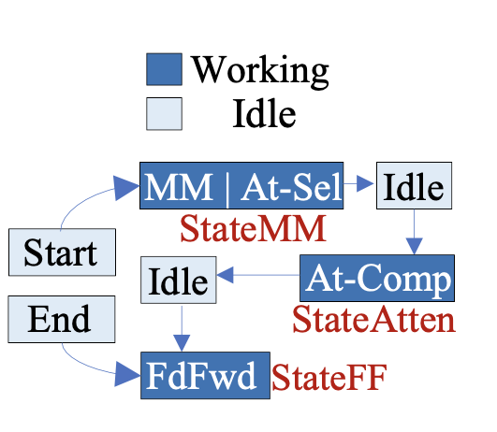

Slide 5
Stage 1: Linear Transformation and Quick Attention Approximations
Components: Incorporates a Matrix Multiplication (MM) unit and attention selection hardware (At-Sel).
Matrix Multiplication (MM) Unit:
Utilizes on-chip Block RAM (BRAM) and Ultra RAM (URAM) to buffer sub-matrices.
Implements a coarse-grained pipeline to minimize communication overhead.
Bits Selector Hardware:
Directly processes the MM result for ultra-low bit quantization.
Outputs are stored in an on-chip buffer for pre-selection computations.
Candidate Pre-Selection:
Employs Look-Up Table (LUT) hardware for approximate distance calculations.
Merge Sort Hardware:
Facilitates scalable, high-throughput (II=1) Top-k sorting.
The sorted Top-k index and value pairs are stored back in High Bandwidth Memory (HBM) for inter-stage buffering.
Stage 2: Attention Computation (At-Comp), Divided into Three Sub-Stages
Data Loading (Stage 2.1):
Utilizes Top-k results from Stage 1 to select attention candidates.
Chooses candidates K_{si}​ and V_{si}​ matrix based on Q_{rowi}​.
Loop Fusion Implementation (Stage 2.2):
Integrates operations from loop fusion
Final Matrix Multiplication (Stage 2.3):
Performs Zi​=Si​⋅V/sum(Si​) operation for each row i.
Double-buffers added between stages for buffering data produced/consumed by adjacent stages.

Slide 6
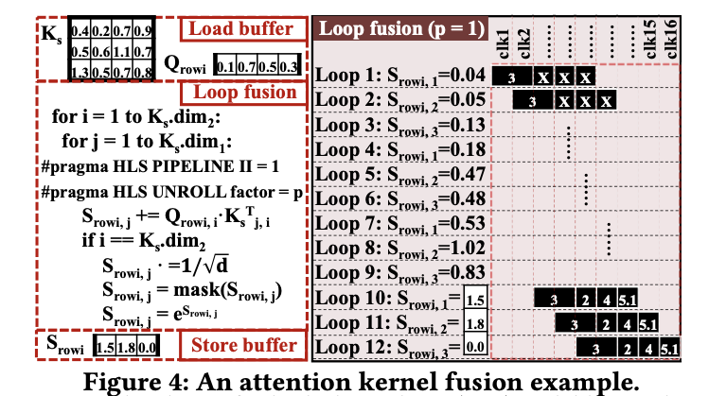
Stage 3: Feedforward
Components: Comprises Matrix Multiplication (MM), addition, layer normalization, and GELU unit.
Memory and Loop Allocation: Leverages on-chip memory and effective loop allocation to reduce communication bottlenecks between on and off-chip memory.
Softmax Division in Stage 2
Process Division: Softmax operation is split into exponent calculation and normalization.
Fine-Grained Pipelining: Used in FPGA to fuse multiple attention operators into a single loop. This fusion allows for operations like scaling, mask, and exponential calculations to be executed in the last loop iterations.
Row and Candidate Processing: Each processed row Qrowi​ and corresponding selected candidate Ks​ are handled with consideration of their dimensional sizes (.1Ks​.dim1​ and .2Ks​.dim2​).

Slide 7
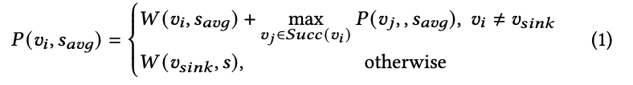
Length-aware Scheduling Algorithm
Problem with Variable Sequence Lengths: Different lengths of sequence tasks consume varying computational resources and result in different latencies. This variability leads to pipeline bubbles due to irregular and unpredictable dataflow.
Solution:
Resource Scheduling Algorithm and Length-aware Coarse-grained Pipeline Algorithm.
Encoder Coarse-Grained Stage Allocation Algorithm
1. Operator Graph (G=(V,E)): The algorithm considers an operator graph where each vertex vi​ in V represents an operator, and each edge eij​ represents the data dependency between operators vi​ and vj​.
Weight Assignment: Each vertex vi​ has an associated weight W(wi​, s_avg​), reflecting its arithmetic computational complexity at an average sequence length s_avg​.
2. Processing and Output
Inputs: The algorithm takes the operator graph G, Encoder operator weight set W(V,s_avg​), and Encoder operator priority set P(V,s_avg​) as inputs.
Outputs: It generates a subgraph Gk​=(Vk​,Ek​) for each Encoder computation stage.
3. Priority Equation
Priority Calculation: The priority of each operator vi​ at the average sequence length s_avg​ is calculated using the equation P(vi​,s_avg​).

Slide 8
Encoder Coarse-Grained Stage Allocation Algorithm
Inputs and Outputs of the Algorithm
Inputs:
Encoder Operator Graph G=(V,E): A graph where each vertex vi​ represents an operator, and each edge eij represents a data dependency between operators vi​ and vj​.
Encoder Operator Weight Set W(V,s_avg): This set represents the computational complexity (weight) of each operator in the graph at an average sequence length s_avg​.
Encoder Operator Priority Set P(V,s_avg) This set determines the priority of each operator at the average sequence length.
Outputs:
Operator Subgraph for Each Encoder Computation Stage Gk=(Vk,Ek) The algorithm outputs a series of subgraphs, each representing a stage in the computation process with its allocated operators.
Detailed Process of the Algorithm
Traversal and Priority Computation: The algorithm begins by traversing the operator graph G and computing a priority set P(V,s_avg) for each operator in the Encoder. The priority is calculated based on the operator's weight and the maximum priority among its successor operators, as shown in the provided equation.
Stage Allocation and Parallelism Adjustment:
The algorithm iteratively processes each operator in decreasing order of priority.
For each operator vi​, it evaluates and potentially adjusts the parallelism N′ of other operators vj​ in the current stage Gk​.
If the current allocation of resources satisfies the FPGA's constraints, the operator vi​ is added to the current stage Gj. The operator parallelisms N(V) are updated accordingly.
If the resources are insufficient, a new stage is created, and the operator vi​ is allocated to this new stage Gk​.
Pipeline Replication Factor Enumeration:
The algorithm also involves enumerating the pipeline replication factor R(Gk,s_avg) for each stage to optimize throughput and resource utilization. This factor determines how many times each stage is replicated to handle the workload.

Slide 9
Parallelism
Parallelism in a length-aware scheduling algorithm, refers to the capability of processing multiple operations or tasks simultaneously within the same stage of the pipeline.
Example in Length-aware Scheduling:
Operator Parallelism Adjustment: Consider a scenario where the FPGA is tasked with processing a batch of data sequences. In the given algorithm, each operator (vertex in the operator graph G) has a certain level of parallelism denoted as N(vi,si), which is dynamically adjusted.
Dynamic Parallelism: For example, if an operator processes sequences of varying lengths, the algorithm adjusts the parallelism based on the length of each sequence. If a sequence is longer and more complex, the algorithm may increase the parallelism for that operator, allowing it to process more elements of the sequence simultaneously.
Efficiency: This dynamic adjustment ensures that each stage of the pipeline operates efficiently, avoiding bottlenecks and making the best use of the FPGA’s resources.
Replication Factor
The replication factor, denoted as R(Gk,si) in the algorithm, refers to the number of times a stage in the pipeline is replicated to handle concurrent processing of different tasks or different parts of a task.
Example in Length-aware Scheduling:
Stage Replication: Imagine a pipeline stage that's responsible for a certain operation on the data sequences. If there are multiple sequences to process at once, the algorithm might replicate this stage multiple times.
Concurrency in Processing: For instance, if there are 10 sequences and the replication factor is set to 5, the algorithm creates 5 copies of this stage. Each replicated stage can then process two sequences simultaneously, thus enhancing the throughput.
Optimization: The replication factor is determined based on the resource availability and the need for throughput. This ensures that the FPGA is neither underutilized (leading to slower processing times) nor overburdened (which might cause delays due to resource contention).
Sorting Sequences in Decreasing Order
Efficiency in Processing: Sequences are sorted and processed in decreasing order of length. This ordering is effective because it allows the system to handle the most resource-intensive tasks first. As these tasks progress through the pipeline, resources are freed up and can be reallocated to shorter, less resource-intensive tasks.
Minimizing Pipeline Bubbles: This approach helps in dynamically patching pipeline bubbles. As longer sequences, which typically take more time, are processed first, the subsequent shorter sequences can be processed without waiting, thus keeping the pipeline consistently busy and reducing idle time.

Slide 10
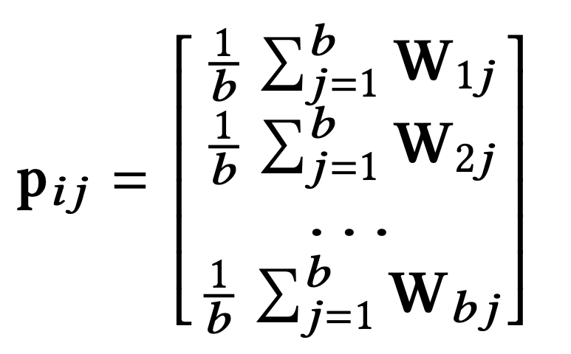
BCM
Block-Circulant Matrices: In BCM, the original weight matrix of a neural network is replaced with block-circulant matrices. A circulant matrix is a special kind of matrix where each row is a cyclic shift of the row above it. In the context of a Transformer, which typically includes weight matrices WiQ​, WiK​, WiV​ (for Query, Key, Value in attention mechanism), BCM involves decomposing these matrices into smaller block-circulant matrices.
Matrix Partitioning: Given a weight matrix W with dimensions m×n, it is partitioned into f×g blocks, where f=m÷b and g=n÷b, with b being the row/column size of each circulant matrix.
Storage Efficiency: Only the first row/column of each block-circulant matrix, called the index vector pij​, needs to be stored and computed, significantly reducing storage requirements.
Enhanced BCM Formulation
The enhanced BCM approach modifies the formulation of the index vector pij​ for better performance in large-scale language models.

Slide 11
Compiler Optimizations for BCM
1. Block Size (b)
Importance: The size of the blocks into which the weight matrices are partitioned affects both the compression ratio and the computational efficiency of the FFT operations.
Optimization Strategy: The compiler could test different block sizes and evaluate their impact on model performance and compression. Smaller blocks might lead to better compression but could potentially increase computational overhead. Find the optimal block size.
2. Precision and Quantization
Importance: The precision of the stored weights (e.g., float32, float16) affects both the memory and the model's accuracy.
Optimization Strategy: Implementing automated quantization strategies where the compiler tests different precision levels and selects the one that provides a balance between model size and accuracy.
3. Sparsity
Importance: Some BCM implementations may incorporate sparsity in the circulant matrices to further reduce memory requirements.
Optimization Strategy: The compiler can analyze the weight matrices to determine the degree of sparsity that can be applied without significantly affecting the model's performance.
4. Index Vector Calculation Method
Importance: In enhanced BCM, the method of calculating the index vector (e.g., averaging across rows/columns)
Optimization Strategy: Experiment with different methods of calculating the index vector and evaluate their impact on the model's performance.
5. Model Layer Analysis
Importance: Different layers of a neural network might benefit differently from BCM compression.
Optimization Strategy: Analyze each layer's characteristics and determine which layers are suitable candidates for BCM compression. Some layers might be more sensitive to compression than others.

Slide 12
DFX: A Low-latency Multi-FPGA Appliance for Accelerating Transformer-based Text Generation

Slide 13
1. Two main model parallelism schemes: pipelined parallelism and intralayer parallelism.
- Pipelined parallelism involves a worker performing a group of operations and passing the output to other workers for further processing, leading to high throughput but unchanged latency.
- In intralayer parallelism, parallelizable operations are divided among multiple devices, reducing operation execution time, but may require synchronization before some operations.
2. DFX Architecture:
- Consists of dual-socket CPUs and multiple FPGAs.
- A system is formed by one CPU and a homogeneous cluster of four FPGAs, each with one compute core.
- Designed for computing independent workloads.
3. Communication and Networking in DFX:
- FPGAs connected to the CPU via PCIe Gen 3, transferring data at 16 GB/s.
- FPGA-to-FPGA communication through QSFP transceiver at 100 Gb/s.
- Utilizes a ring network due to each FPGA having only two QSFP ports, making it scalable.
4. Homogeneous Cluster Operation:
- Each FPGA in the cluster runs identical operations on identical hardware.
- Specifically used for running GPT-2 end-to-end.
5. Data Storage and Precision in DFX:
- Weight matrices stored in HBM (High Bandwidth Memory).
- Input/output tokens, bias vectors, and other parameters stored in DDR, accessed infrequently, with minimal impact on performance.
- Utilizes standard half-precision floating-point (FP16) for model parameters to maintain inference accuracy.

Slide 14
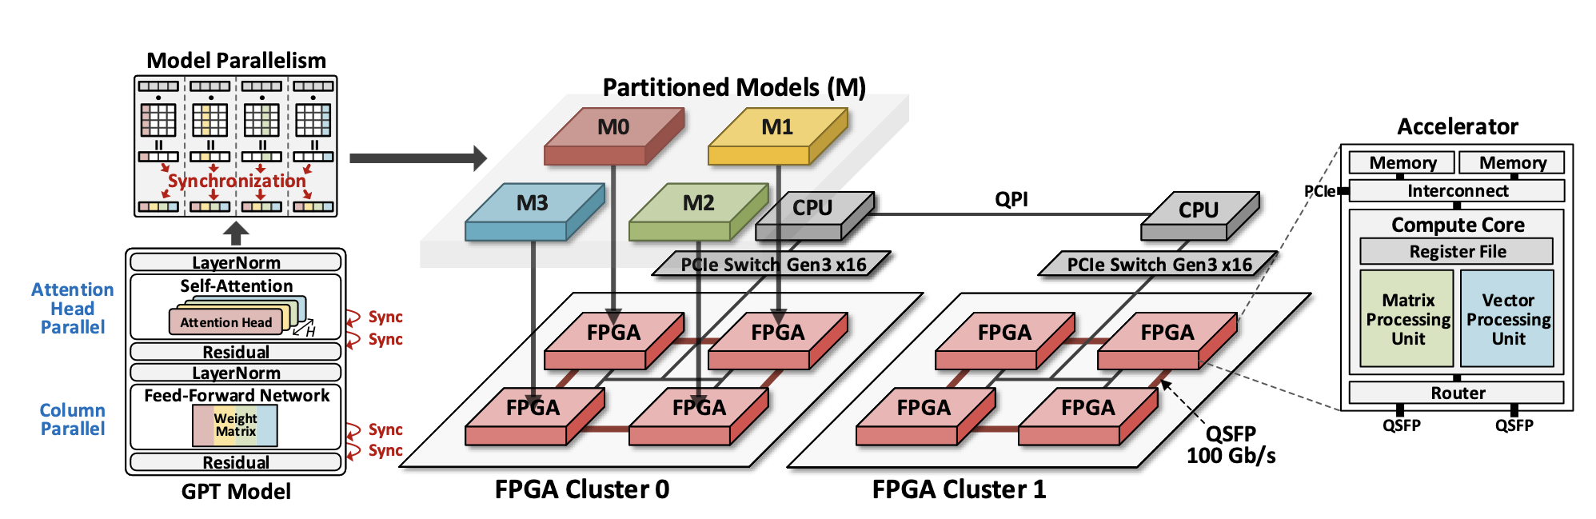

Slide 15
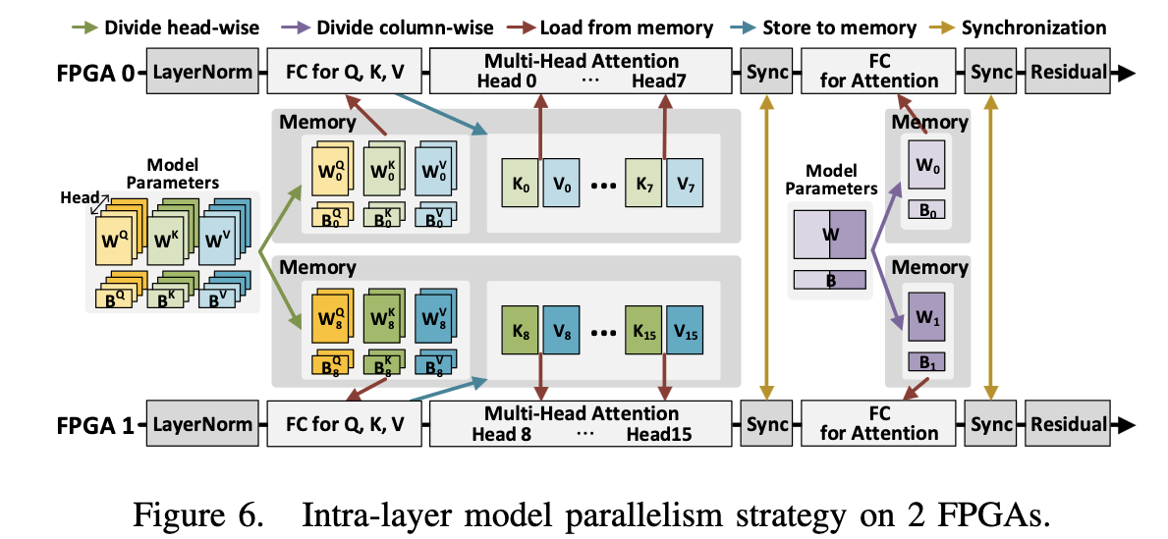

Slide 16
1. Implementation of Model Parallelism:
- Applies model parallelism specifically to model parameters using an intra-layer parallelism scheme.
- Adopts a specific intra-layer partitioning method to reduce latency in matrix operations, proportional to the number of workers, with minimal synchronization overhead.
2. Partitioning of Weight Matrices:
- Multi-head attention weight matrices are divided head-wise.
- Fully-connected layer weight matrices are divided column-wise into two portions, corresponding to the number of FPGAs.
- Each FPGA works individually on its assigned partition.
3. Storage and Execution in FPGAs:
- Partitioned matrices are stored in the memory of the FPGA where their respective core is located.
- Each core executes identical operations in parallel using the partitioned model parameters.
4. Data Synchronization and Circulation:
- Each core obtains a subvector of the output vector from matrix operations.
- Subvectors are circulated to other FPGAs through the ring network for data synchronization.
- After synchronization, each core possesses the complete vector, ready for the next vector operation, like residual.
5. Synchronization Frequency:
- Synchronization is required once during and once after self-attention and feed-forward network operations.
- This results in a total of four synchronizations per decoder layer.
- The approach minimizes data synchronization and transfer among FPGAs while leveraging model parallelism in self-attention and feed-forward network operations.

Slide 17
1. Matrix and Vector Loading:
- Matrices are loaded in tiles and vectors in portions.
- Matrix-matrix multiplications executed through a sequence of matrix-vector multiplications.
2. Conv1D Instruction:
- Used in Query, Key, Value matrix generation and feed-forward networks.
- Operates on the equation Ax + b, requiring weight matrix A, input vector x, and bias vector b.
- Has a convolutional aspect for inputs longer than maximum size, using a sliding window approach.
3. MaskedMM Instruction:
- Executes masked matrix multiplication (MM) with the equation Ax.
- Used for calculating Query × KeyT (Score matrix), loading the Query matrix as vectors.
- Implements masking to put a −∞ mask on upper diagonal elements of the Score matrix, preventing influence from future contexts.
- Works with Softmax to create a lower triangular matrix, outputting each row's maximum value.
4. MM Instruction:
- Similar to MaskedMM but without masking.
- Utilized in the language model (LM) head for logit calculation and in the attention layer for calculating Score × Value.
5. LayerNorm Instruction:
- Executes layer normalization with the equation y(xi) = γi xi−μ /σ + βi.
- Involves calculating mean (using accum and mul) and standard deviation (requiring recip_sqrt).
- Uses sub, mul, and add instructions for execution, with parameters fetched via load instruction.
6. Softmax Instruction:
- Follows the equation y(xi) = exi/ ∑ j ex j, with j representing the number of elements in a row.
- Utilizes basic vector instructions like exp, add, and accum for execution.
- Summation similar to mean calculation in LayerNorm, division achieved through recip and mul instructions.

Slide 18
1. Optimized Tiling Scheme in DFX:
- Aims to maximize computations and throughput, especially during the memory-intensive generation stage, while maintaining performance in the summarization stage.
- In the generation stage, a large number of weights are read from High Bandwidth Memory (HBM) for matrix multiplication.
- Weights are tiled in HBM and read by DMA at a maximum bandwidth of 32 × 512 bits per cycle.
- Tiling dimensions are rearranged to d × l × BWdata, where d is the tile dimension, l is the number of lanes, and BWdata (16) is the data bitwidth.
- The number of lanes corresponds to the number of columns in a tile processed in parallel by matrix function units.
2. Determination of Optimal Tile Dimensions:
- Design space exploration led to the optimal tile dimensions being d = 64 and l = 16.
- Chosen dimensions are based on the attention head dimension (H) of GPT-2 and GPT-3 models, which is around 64.
- Performance degrades when d > 64 for computing Query × KeyT and when l > 64 for calculating Score ×Value due to underutilization of compute units and mismatch with model dimensions.
3. Hardware Resource Utilization:
- d = 64 requires the least hardware resources compared to other options.
- Larger l for d = 16 and d = 32 requires more resources in the matrix processing unit (e.g., accumulators, special function unit operators, and control logic).
- Standardizing hardware with d = 64 and l = 16 minimizes resource use.
4. DMA Loading and Tile Filling:
- DMA loads d × l weights horizontally to fill a tile, then moves to the tile below.
- Horizontal movement maximizes input reuse but requires many buffers for partial sums, leading to on-chip memory constraints.
5. Optimal Direction for Performance:
- Vertical direction reduces buffer requirements but eliminates input reuse, decreasing throughput.
- Zigzag direction with a tile size of d × d is chosen to balance hardware resource usage and data reuse for optimal performance.

Slide 19
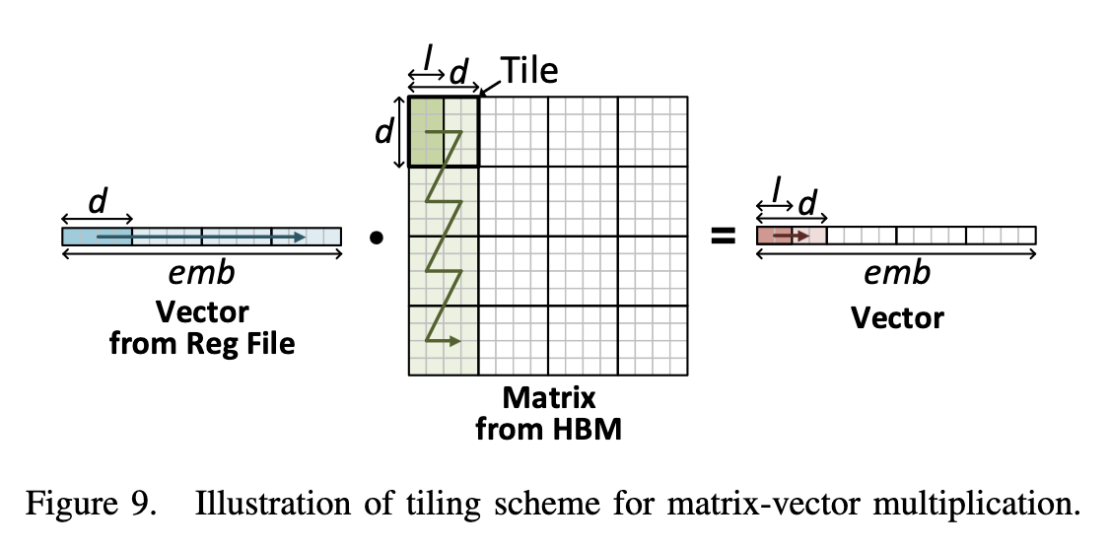
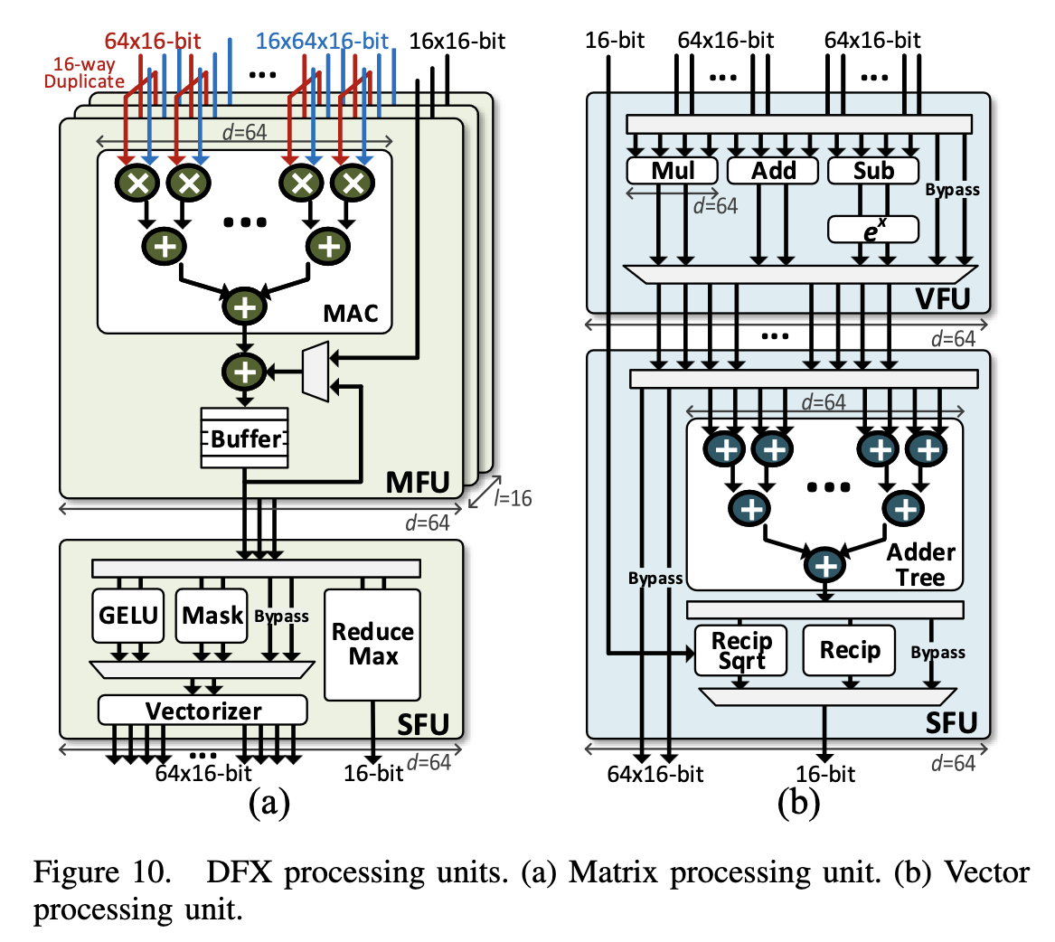

Slide 20
1. DFX Core Processing Units:
- Consists of two main processing units: the Matrix Processing Unit (MPU) and the Vector Processing Unit (VPU).
- Designed to execute mathematical operations for end-to-end acceleration of GPT-2, leveraging parallel computing and hardware resources.
- Includes four main functional units: matrix function unit, vector function unit, and two special function units, all equipped with FP16 operators.
- Functional units feature deep and diverse pipelines for maximum throughput and use bypasses for low-latency asynchronous instruction execution.
2. Matrix Function Unit (MFU):
- Primarily handles matrix-vector multiplication.
- Contains tree-based multiplier-accumulators (MACs) taking vectors of dimension d as input.
- Composed of l lanes, enabling parallel processing of l different multiplicands from the weight matrix, resulting in d × l parallel multiplications.
- Utilizes parallel adder trees (depth of log2(d)) for calculating partial sums.
- Utilizes DSPs (Digital Signal Processing slices): 3 × (d × l) DSPs in total, with d × l for multipliers, 2 × (d − 1) × l for adder trees, and 2 × l for scalar additions.
- In the DFX setup, d and l are set to 64 and 16, respectively, requiring 3072 DSPs for the MFU.
3. Vector Function Unit (VFU):
- Executes vector instructions, functioning as a floating-point arithmetic logic unit (ALU).
- Supports element-wise operations like addition, subtraction, and multiplication for vectors of dimension d.
- Uses DSPs for all operations: addition, subtraction, and multiplication (11 cycles each), and exponential operation (4 cycles, using two DSPs).
- Ensures efficient processing with no instruction requiring more than one ALU operation, minimizing synchronization needs.
- Incorporates a bypass feature for reducing unnecessary computational cycles, allowing instructions like load and store to take only one cycle.
- Manages data hazards in asynchronous dataflow through a scoreboard.

Slide 21
1. Transpose Requirement in Standard Attention Operation:
- Normally, the Key matrix needs to be transposed in standard attention operations.
2. Unique Transpose Scheme in DFX:
- In DFX's dataflow, the multiplicand Value needs transposing due to column-wise reading and row-wise writing from HBM.
- Intermediate matrices, including Value, are automatically transposed when loaded into the DMA.
3. Memory Efficiency Concerns:
- Transposing the entire Value matrix in on-chip memory is inefficient due to its high memory capacity requirements (e.g., 0.31 MB per token for a 1.5B model).
4. Efficient Transpose Method:
- DFX transposes the Value matrix while partial tiles are being written to off-chip memory, rather than during read operations.
- This approach allows the long latency involved in transposing to be effectively hidden by modifying the computation order.
5. Rearrangement of Computation Order:
- Based on GPT's operational sequence, Value^T (transpose of Value) is needed after the generation of Query, Key, and Value.
- In DFX, the order of instructions is rearranged so that Value is computed earlier than Query and Key.
- This rearrangement ensures there is enough time for transposing Value while Query and Key are being generated, optimizing the overall process.

Slide 22
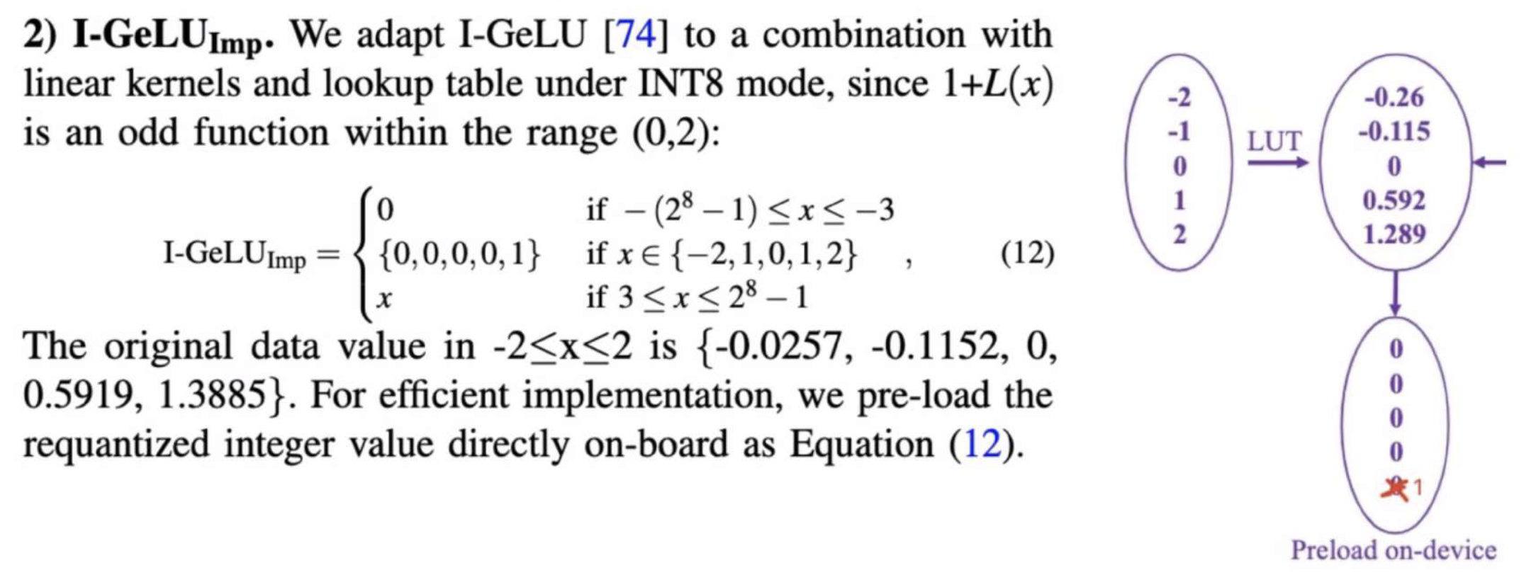

Slide 23
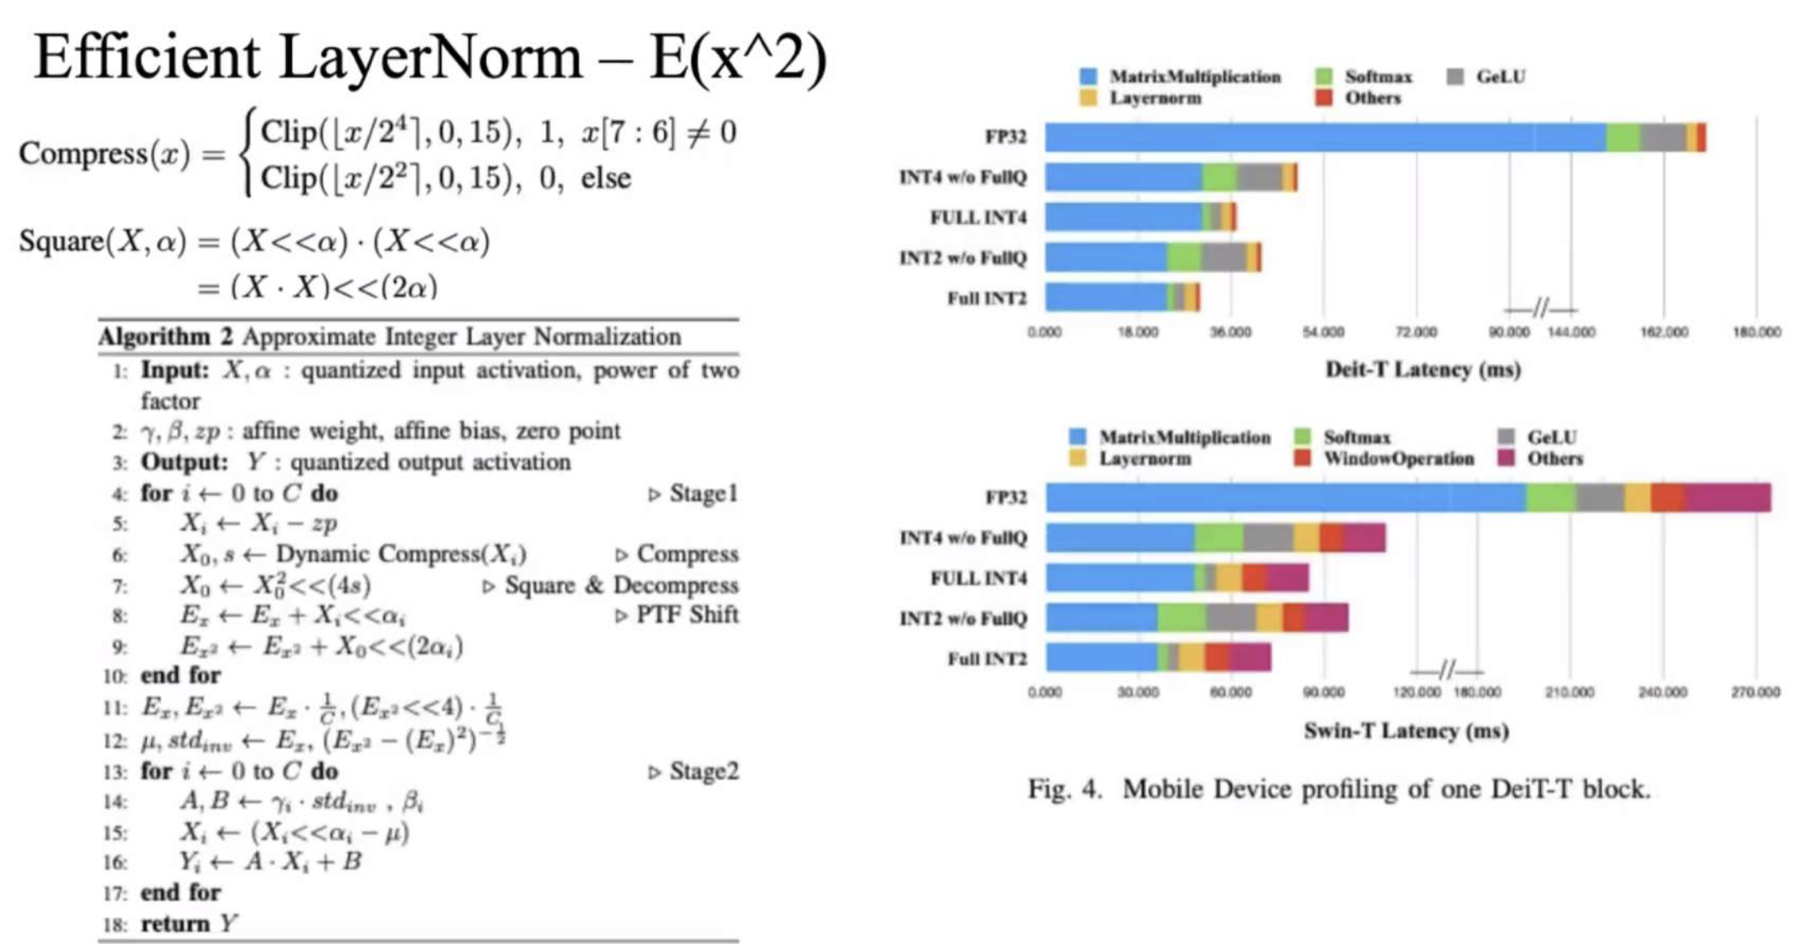

Slide 24
